Slide 1
F# MVC for WPF
Dmitry Morozov
April 23, 2013

Slide 2
GUI APPLICATION DEVELOPMENT
Inherently hard
Essential complexity
OOP was thought as THE way to handle it

Slide 3
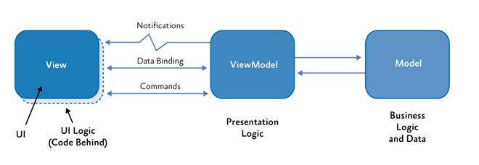
MVvm (Model-View-ViewModel)

Slide 4
Mvvm
Certainly better than old fashion “Autonomous View”
Variation of Martin Fowler’s “Presentation Model” pattern
De-facto standard for XAML-based frameworks
WPF, Silverlight, Windows Store Apps (even WinForms)
For details see Chris Marinos’s “Getting Your Func(tional) on with F#” http://www.meetup.com/nyc-fsharp/events/22059701/
Daniel Mohl’s F# Project Templates:
F# and C# Win App (WPF, MVVM)
F# Windows App (WPF, MVVM)

Slide 5
Mvvm shortcomings
ViewModel = Controller + Model
Grows big. Hard to manage complexity
No support for presentation logic composition
A lot of boilerplate code
INotifyPropertyChanged
IDataErrorInfo or INotifyDataErrorInfo
Hooking up event handlers/commands bindings
Data/Command bindings based on “magic” strings (reflection)
No support from type system/compiler
No support from IDE (refactoring/navigation)
Etc.

Slide 6
Can we do better?

Slide 7
FIRST class EventS-Driven architecture
type Events =
| Add of int
| Subtract of int
type View = IEvent<Events>
type Model = { State : int }
type Controller = (Events -> Model -> Model) -> Model -> IEvent<Events> -> Model

Slide 8
model
Based on Castle Dynamic Proxy
Raises INPC.PropertyChanged from setter interceptor
Restrictions: base class + factory method
Support for abstract properties makes coding in F# easier
DECLARATIVE (type definition only, no imperative logic)

Slide 9
VIEW
Event source
Data binding target
type IView<'Events> =
inherit IObservable<'Events>
abstract SetBindings : obj -> unit

Slide 10
Model – subset of view state
View
Model
Data binding

Slide 11
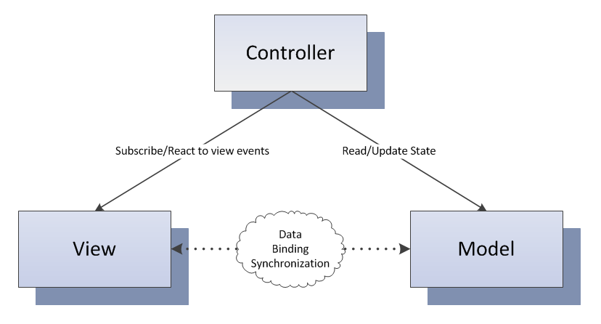
Controller
YOUR PRESENTATION LOGIC HERE

Slide 12
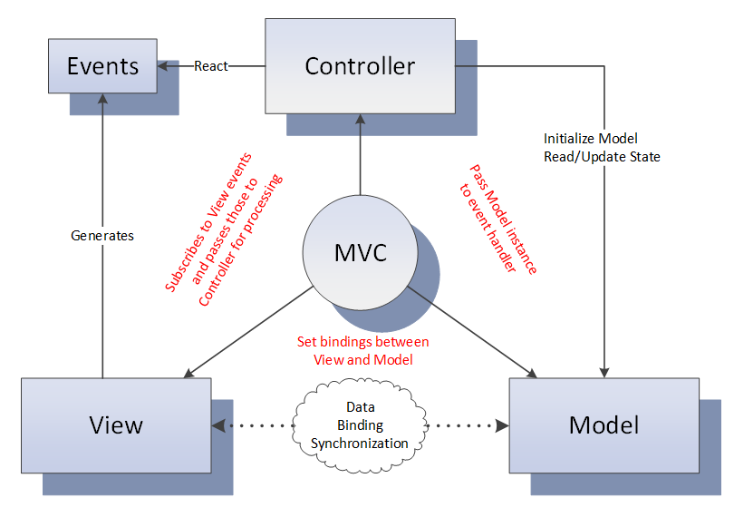
MVC – gluing pieces together
Depends only on ‘Events and ‘Model –
TESTABILITY

Slide 13
Data binding
type IView<'Events, 'Model> =
inherit IObservable<'Events>
abstract SetBindings : 'Model -> unit
<@ control.Property <- model.Property @>
Making implicit dependency explicit
Leveraging F#/.NET type system
Leveraging IDE/compiler
Doing something slightly better than “by convention”
Optional module

Slide 14
Validation
Optional module
Would be verbose without F# language features:
Active patterns
Explicit member constraints
Partial application

Slide 15
Async
type IController<'Event, 'Model> =
abstract InitModel : 'Model -> unit
abstract EventHandler : ('Event -> 'Model -> unit)
type EventHandler<'Model> =
| Sync of ('Model -> unit)
| Async of ('Model -> Async<unit>)
type IController<'Events, 'Model> =
abstract InitModel : 'Model -> unit
abstract Dispatcher : ('Events -> EventHandler<'Model>)
“Async in C# and F#: Asynchronous gotchas in C#” blog post by Tomas Petricek

Slide 16
Child Windows
Dialog – synchronous computation
Non-modal window - asynchronous

Slide 17
Reentrancy
Very tricky problem

Slide 18
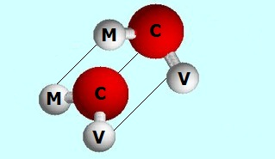
composition

Slide 19
External event sources
As easy as composing views
Rx.NET helps to ensure invocation on GUI thread
Another composition option

Slide 20
Data binding micro dsl
Scrap your boilerplate
F# gives great tools to build internal DSLs

Slide 21
Derived properties
Scrap your boilerplate
F# pure magic
ReflectedDefinitionAttribute
Quotation
Active patterns (a lot)
WPF black magic
Custom dynamic dependency properties
MultiBinding

Slide 22
F# 3.0/.net4.5
Queries
Type providers
WSDL
XAML
INotifyDataErrorInfo
ExceptionDispatchInfo

Slide 23
F# MVC for WPF
No INPC boilerplate model
Abstract polymorphic view
Loosely couple controller
Type checked event to handler mapping
Statically typed data-binding DSL
Lightweight validation
Type system supported Async
Dialogs/Windows as sync/async workflows
Reentrancy problem solved at one place
COMPOSITION
External event source
Declarative derived properties
Queries, type providers …

Slide 24
In summary
F# great general purpose language
Hard things easy impossible things possible
GitHub: http://github.com/dmitry-a-morozov/fsharp-wpf-mvc-series
Wiki: http://github.com/dmitry-a-morozov/fsharp-wpf-mvc-series/wiki

